Slide 1

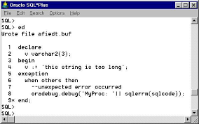
PL/SQL

Slide 2
Declaring Variables with the %ROWTYPE Attribute
Declare a variable with the type of a ROW of a table.
And how do we access the fields in employee_record?
employee_record employee%ROWTYPE;
Accessing table Employee
employee_record.eid:=9;
employee_record.did:=877;

Slide 3
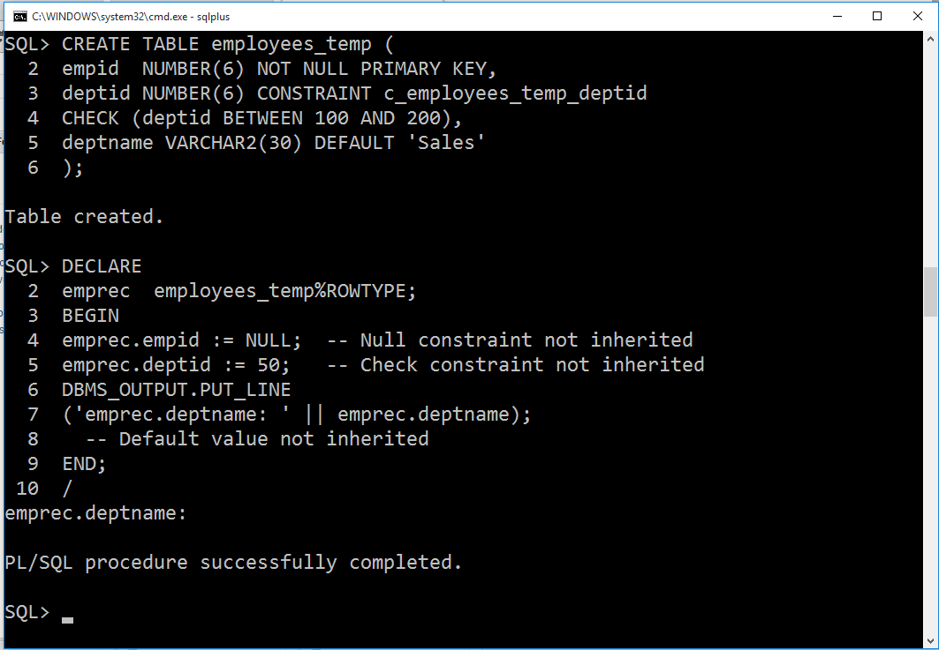
%ROWTYPE - Example

Slide 4
%ROWTYPE – Example (2)
Set serveroutput on
DECLARE
v_employee employee%rowtype;
BEGIN
select * into v_employee
from employee
where eid=123;
DBMS_OUTPUT.PUT_LINE (v_employee.ename);
DBMS_OUTPUT.PUT_LINE (v_employee.adreee);
DBMS_OUTPUT.PUT_LINE (v_employee.age);
END;
/

Slide 5
SUBSTITUTIONVARIABLES
SQL*Plus allows a PL/SQL block to receive input information with the help of substitution variables.
Substitution variables cannot be used to output the values because no memory is allocated for them.
SQL*Plus will substitute a variable before the PL/SQL block is sent to the database.
Substitution variables are usually prefixed by the ampersand(&) character or colon (:) character.

Slide 6
EXAMPLE-(1)
DECLARE
v_student_id NUMBER := :sv_student_id;
v_first_name VARCHAR2(35);
v_last_name VARCHAR2(35);
BEGIN
SELECT first_name, last_name
INTO v_first_name, v_last_name
FROM student
WHERE student_id = v_student_id;
DBMS_OUTPUT.PUT_LINE
('Student name: '||v_first_name||' '||v_last_name);
EXCEPTION
WHEN NO_DATA_FOUND THEN
DBMS_OUTPUT.PUT_LINE('There is no such student');
END;

Slide 7
EXAMPLE-(2)
BEGIN
DBMS_OUTPUT.PUT_LINE('Today is ‘||’:sv_day');
DBMS_OUTPUT.PUT_LINE('Tomorrow will be ‘||’ :sv_day');
END;
This example produces the following output:
Today is Monday
Tomorrow will be Tuesday
PL/SQL procedure successfully completed.

Slide 8
Guided Activity-4
Q1: Write Pl/Sql program to Calculate and display the net Salary where DA Is 30% Of Basic, HRA Is 10% Of Basic for the employee whose employee_id is given by user.
Q2: Write Pl/Sql program to enter record in Employee_New table from employee table of the employee whose employee_id is provided by the user.
Estimated Time: 30 Minutes.

Slide 9
Conditional Statements
Conditional Processing
The specified
conditions are
evaluated by the
system and the result
determines which
sequence of
statements is to be
carried out.
IF <boolean expression> THEN
<sequence of statements>
END IF;
---------------------------------------------------------------------------------------------
IF <boolean expression> THEN
<sequence of statements>
ELSE
<sequence of statements>
END IF;
Notes:
This slide begins to talk about the flow of PL/SQL.
Here is conditional process using :
if …then…else..end if;
if then elsif…then…end if;…

Slide 10
Conditional Statements (ELSIF)
IF <boolean expression> THEN
<sequence of statements>
ELSIF <boolean expression> THEN
<sequence of statements>
ELSIF <boolean expression> THEN
<sequence of statements>
ELSIF <boolean expression> THEN
<sequence of statements>
ELSE
<sequence of statements>
END IF;
Notes:
Conditional process continues.

Slide 11
EXAMPLE
DECLARE
a number(3) := 100;
BEGIN
IF ( a = 10 ) THEN
dbms_output.put_line('Value of a is 10' );
ELSIF ( a = 20 ) THEN
dbms_output.put_line('Value of a is 20' );
ELSIF ( a = 30 ) THEN
dbms_output.put_line('Value of a is 30' );
ELSE
dbms_output.put_line('None of the values is matching');
END IF;
dbms_output.put_line('Exact value of a is: '|| a );
END;
Output:
None of the values is matching
Exact value of a is: 100

Slide 12
EXAMPLE (2)
DECLARE
c_id customers.id%type := 1;
c_sal customers.salary%type;
BEGIN
SELECT salary INTO c_sal FROM customers WHERE id = c_id;
IF (c_sal <= 2000) THEN
UPDATE customers SET salary = salary + 1000
WHERE id = c_id;
dbms_output.put_line ('Salary updated');
END IF;
END;
Output:
Salary updated

Slide 13
Guided Activity-5
Q1: Write a PL/SQL code block to find greatest of three numbers.
Q2: Write a PL/SQL script to compare three given numbers and display them in ascending order.
Q3: Write a PL/SQL program to check whether the given number is even or odd.
Estimated Time: 30 Minutes.

Slide 14
Loop Structures
Unconstrained loops
WHILE loop
FOR loop
Notes:
This slide shows the five type of loops in PL/SQL.

Slide 15
Unconstrained Loops
LOOP
<sequence of statements>
EXIT WHEN <condition>
<sequence of statements>
END LOOP;
Notes:
The structure of unconstrained loop.
There is no condition test done before the loop.
We can go out of the loop with the condition tested inside the loop .

Slide 16
Loops: Simple Loop
create table number_table(
num NUMBER(10)
);
DECLARE
i number_table.num%TYPE := 1;
BEGIN
LOOP
INSERT INTO number_table
VALUES(i);
i := i + 1;
EXIT WHEN i > 10;
END LOOP;
END;
Notes:
Basic Loop
The basic loop example shown in the slide is defined as follows: insert the first 10 new line items for order number 101.
Note: A basic loop allows execution of its statements at least once, even if the condition has been met upon entering the loop.

Slide 17
WHILE LOOP
WHILE <condition>
LOOP
<statements>
END LOOP;
Note: The loop will continue to process as long as the condition is TRUE or an EXIT (or EXIT WHEN) statement is encountered.
Notes:
While loop structure.

Slide 18
Loops: WHILE Loop
DECLARE
TEN number:=10;
i number_table.num%TYPE:=1;
BEGIN
WHILE i <= TEN LOOP
INSERT INTO number_table
VALUES(i);
i := i + 1;
END LOOP;
END;
Notes:
WHILE Loop
In the example in the slide, the quantity increases with each iteration of the loop until the quantity is no longer less than the maximum price allowed for spending on the item.

Slide 19
FOR LOOP
FOR <loop_counter> IN [REVERSE]
<low bound>..<high bound>
LOOP
<sequence of statements>
END LOOP;
Notes:
For loop structure.
The condition is tested before begins the loop.
The start value is smaller than the end value.

Slide 20
Loops: FOR Loop
DECLARE
i number_table.num%TYPE;
BEGIN
FOR i IN 1..10 LOOP
INSERT INTO number_table VALUES(i);
END LOOP;
END;
Notice that i is incremented automatically

Slide 21
Creating a PL/SQL Record
A record is a type of variable which we can define (like ‘struct’ in C or ‘object’ in Java)
DECLARE
TYPE emp_record_type IS RECORD
(ename VARCHAR2(10),
eid VARCHAR2(9),
age NUMBER(3),
did NUMBER(3));
emp_record emp_record_type;
...
BEGIN
emp_record.ename:=‘peter’;
emp_record.age:=45;
…

Slide 22
PL/SQL Sample Program
Set serveroutput on
DECLARE
v_inv_value number(10,2);
v_price number(8,2) := 10.25;
v_quantity number(8,0) := 400;
BEGIN
v_inv_value := v_price * v_quantity;
dbms_output.put('The value is: ');
dbms_output.put_line(v_inv_value);
END;
/

Slide 23
PL/SQL Comments
DECLARE
v_salary number(9,2) := 40000;
BEGIN
/* this is a multi-line comment that
will be ignored by the pl/sql
interpreter */
v_salary := v_salary * 2; -- nice raise
END; -- end of program

Slide 24
COMMON PL/SQL STRING FUNCTIONS
CHR(asciivalue)
ASCII(string)
LOWER(string)
SUBSTR(string,start,substrlength)
LTRIM(string)
RTRIM(string)
LPAD(string_to_be_padded, spaces_to_pad, |string_to_pad_with|)
RPAD(string_to_be_padded, spaces_to_pad, |string_to_pad_with|)
REPLACE(string, searchstring, replacestring)
UPPER(string)
INITCAP(string)
LENGTH(string)

Slide 25
COMMON PL/SQL NUMERIC FUNCTIONS
ABS(value)
ROUND(value, precision)
MOD(value,divisor)
SQRT(value)
TRUNC(value,|precision|)
LEAST(exp1, exp2…)
GREATEST(exp1, exp2…)

Slide 26
EXAMPLE
DECLARE
greetings varchar2(11) := 'hello world';
BEGIN
dbms_output.put_line(UPPER(greetings));
dbms_output.put_line(LOWER(greetings));
dbms_output.put_line(INITCAP(greetings));
/* retrieve the first character in the string */
dbms_output.put_line ( SUBSTR (greetings, 1, 1));
/* retrieve the last character in the string */
dbms_output.put_line ( SUBSTR (greetings, -1, 1));
/* retrieve five characters, starting from the seventh position. */
dbms_output.put_line ( SUBSTR (greetings, 7, 5));
/* retrieve the remainder of the string, starting from the second position. */
dbms_output.put_line ( SUBSTR (greetings, 2));
/* find the location of the first "e" */
dbms_output.put_line ( INSTR (greetings, 'e'));
END;

Slide 27
Guided Activity-6
Q1: Write a PL/SQL code block to find area of circles with radius greater than 3 and less than equal to 7 and store the result in a table with attributes radius and area.
Q2: Write a PL/SQL code block to find factorial of a number.
Q3: Write a PL/SQL code block to generate Fibonacci series.
Estimated Time: 30 Minutes.

